Slide 1
M2W1: Statistical Learning - Basic Statistics
Agenda:
Applied Statistics & Big Data – An Introduction
Descriptive Statistics
Data and Types
Univariate Distributions – Type, Shape, Central Tendency (3Ms), Dispersion
Bivariates – Tables, Box plots, Scatter plots, Quantiles, Q-Qs
Empirical and Chebyshev Rule
Covariance & Pearson’s Correlation
Case Study – Customer Churn w.r.t Telecom Provider

Slide 2
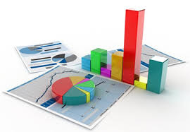

Classical Definitions
"Statistics is the aggregate of facts affected to a marked extent by the multiplicity of causes, numerically expressed, enumerated or estimated according to reasonable standards of accuracy, collected in a systematic manner for a pre-determined purpose and placed in relation to each other- Prof. Horace Secrist”
Business Analytics (BA) can be defined as the broad use of data and quantitative analysis for decision making within organizations.
Statistics
Data!
Data Collection & Organization
Data Analysis (EDA)
Interpretation of Analysis
Presentation of findings
The underlying Science
that involves
Quantitative
basis
*Data Science is a field which encompasses
Statistical methods, tools, processes and systems
Purpose
(Applied Statistics?)
Business Analytics

Slide 3




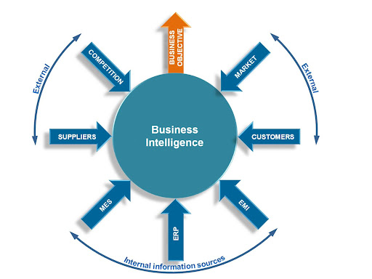



Relevance of Statistics Today?
Technology Development
Data Explosion
Internet Revolution
& Social Networking
Smart /mobile phones
Data driven Organizations
Data insights drive
Customer understanding
Competitive Advantage
& Profitability in Market
Computing Power to:
Process & analyze “large” data
Faster & Sophisticated
Algorithms for problem solving
Data driven Organizations
Data visualizations for BI (Business Intelligence) & AI (Artificial Intelligence)
Statistics?
Large Data Storage Capacity
Parallel & Cloud Computing

Slide 4
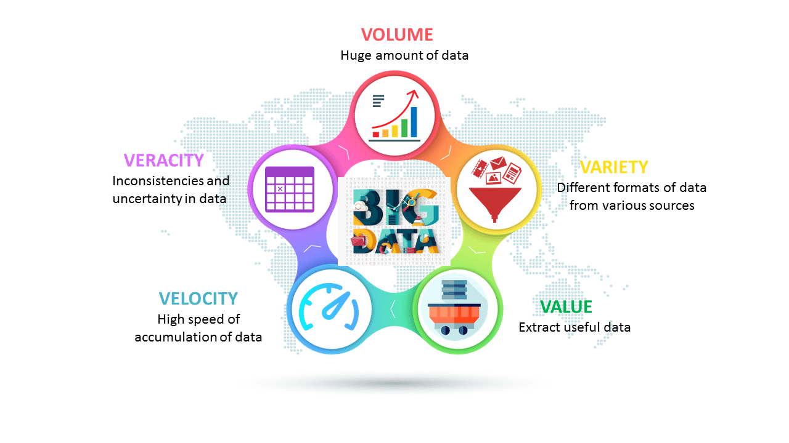
Statistics and Big Data Today?
Big Data
A set of data that cannot be managed, processed, or analysed with
traditional software/algorithms within a reasonable amount of time.
Big data revolves around the 5Vs:
-Volume, Velocity, Variety, Value, Veracity .
Volume
→ = *1000
KB → MB → GB → TB → PetaB → ExaB → ZetaB → YottaB
Structured data – DBs,
Unstructured data – Weather,
Geo-spatial, Media data, NLP
Semi-structured – HTML code
Small ascii data file,
thumb size photo (jpg)
Amazon: 20 orders Per sec,
Twitter: 500M tweets / day,
FB: 900M photos upload / day,
4M Google searches /day
HD Movie file,
50 hrs of browsing
This Ppt file, mp3 audio,
medium industry datasets (csv)
Desktop drive , Personal
HDD, 8 smartphones
Data storage capacity of FB, All words spoken
by Humans ever
Autonomous car
data in 1 year,
Annual Internet traffic

Slide 5

Statistical Methods
Pattern Recognition
Unearth hidden patterns in Data
Visual analytics: Histograms, Box-plots,
Scatter/Line Plots
Feature extraction, clustering, discrimination
Speech (acoustic patterns) recognition, character
recognition (image patterns)
Classifications
Segmentation of customers
Brand/Product positioning
Event Success vs Failure
Demographics & Psychographics
Classifying for Social Networking
Statistics
Associations
Associations amongst variables
Measures: Pearson’s correlation, chi-square test, Relative risk & odds ratio etc
Association Rule: Market basket analysis
for association amongst items
Popular usage in epidemiology, psychology studies
Predictive Modeling
Supervised and Unsupervised ML models
Classification, Regression, Clustering models
Algorithms such as Linear Regression, Naïve Bayes,
Logistical Regression, K-Nearest-Neighbors,
Decision Trees, Ensembles, Neural-Networks etc

Slide 6
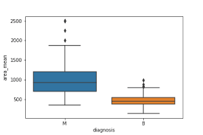
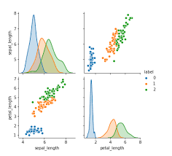
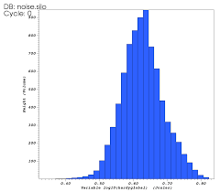
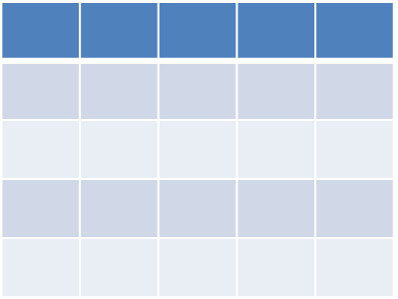
Applied Statistics – Key Terms
Parameter 1
Parameter 2
….
Hypothesis
Population
Predictions
Inferential Statistics
(Probability models,
Hypothesis testing
Regression & Correlation Analysis)
Inference
Generalization
Sampling of
Population
-”Data Collection Phase
3Ms – Mean, Median, Mode
Sample (s)
5-Number
Summary
Tables
Statistic 1
Statistic 2
……
Distribution
Central Tendency
Dispersion/ Variation
Variance
Std. Dev
Descriptive Statistics

Slide 7
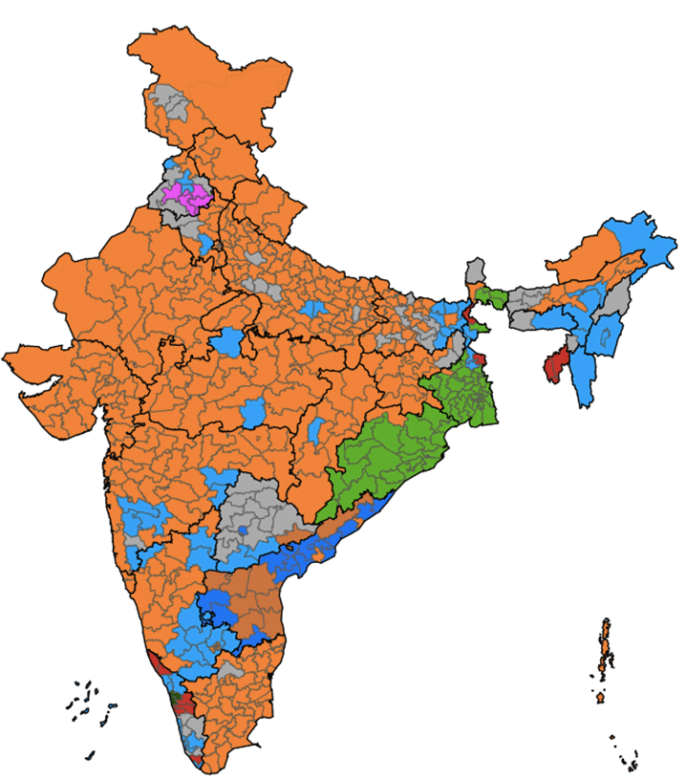
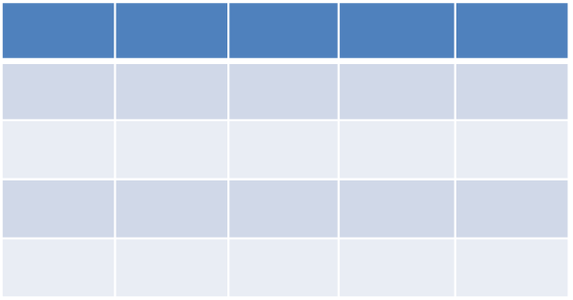
Statistics – Key Terms (A Psephologist’s Example)
Electorate split amongst
542 Constituencies in India
(People of each constituency)
[‘Age’, ‘Gender’, ‘Const’, ‘Caste’, ‘Religion’, …..’Vote pref”, ‘Reason’]
“Dataset”
“Attribute”
“Sample”
(Survey 1400 people
Per constituency)
750K people sampled
“Data
Collection”
“Data Object”
EDA → ‘Descriptive Statistics’
Sample “Statistics” – Age & Gender distribution,…..
“Population”
(~600M voters out of
900M eligible to vote)
Predictive Models
→ ‘Inferential Statistics’
Population “Parameters” – %Vote share, Const. Seat winner etc

Slide 8
Classical definition & Types of stats
Types of Statistics
Descriptive Statistics is concerned with Data summarization, Graphs/Charts, and tables
Inferential Statistics is a method used to talk about a Population parameter from a sample
Population, Parameter, Sample, Statistic
A Population is the universe of possible data for a specified object.
A Parameter is a numerical value associated with a population.
A Sample is a selection of observations from a population
A Statistic is a numerical value associated with an observed sample.

Slide 9
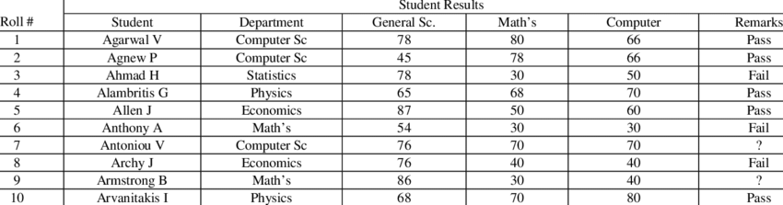
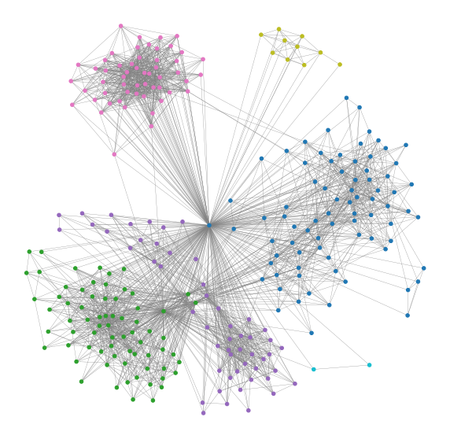
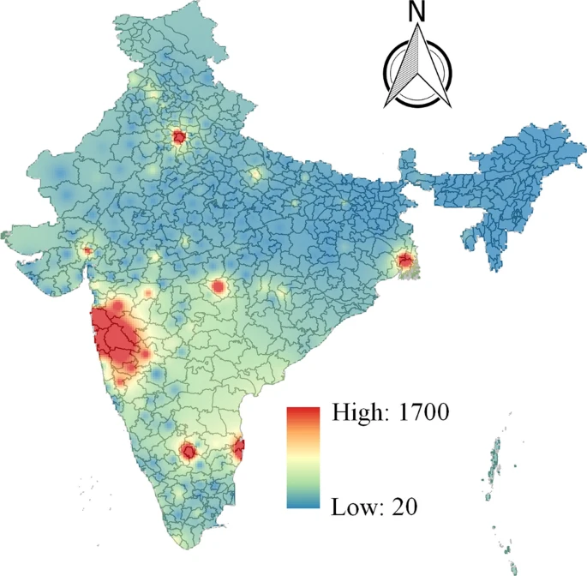
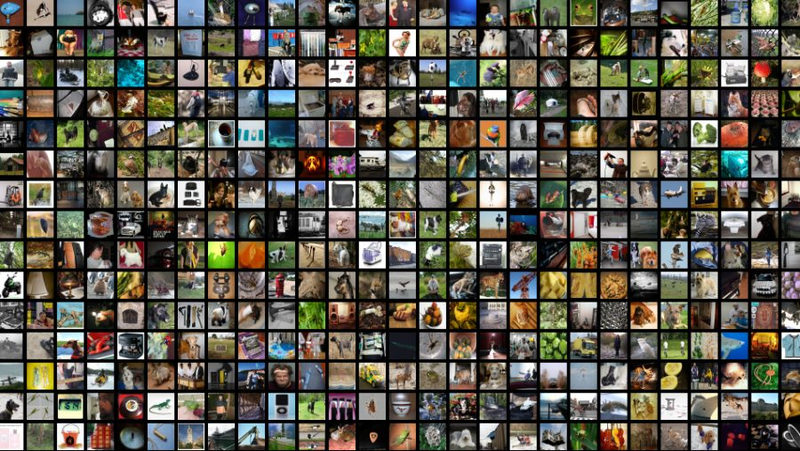
Sources and Types of data
Record
Types of datasets
Record
Graph and network
Ordered
Spatial, Image and Multimedia
FB Ego-Network
Image dataset
Covid19 Spatial Map
April’21 Dataset

Slide 10
Data?
Primary Data
“Collected afresh”
Data
Secondary Data
“Legacy data collected
for other purposes”
Qualitative
(Categorical)
Quantitative
(Numerical)
Nominal
Binary
Ordinal
Discrete
Continuous
Symmetric
Asymmetric
‘Uneducated’
‘Class X’
‘Class XII’
‘UG’
‘PG’
‘True’/
‘False’
‘Family size’
(count)
‘Weight’
(in Kgs)
‘Religion’

Slide 11
Data Objects, Attributes and its Types
Data Objects
Data sets are made up of Data Objects.
A data object represents an entity.
Data objects are described by attributes.
Examples:
sale database : customers, sales
medical database: patients, treatments
Attributes
Attribute: a data field, representing a characteristic or feature of a data object. Example: customer_ID, name, address
Attribute Types: Nominal, Binary, Ordinal, Numeric
Example:
Uber Drive Dataset
Single Drive (Journey) – Data Object
‘Miles’ (Journey distance) – Attribute
‘Miles’ Attribute is numeric data type

Slide 12
Week 1 : Descriptive Statistics

Slide 13
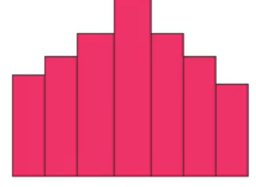
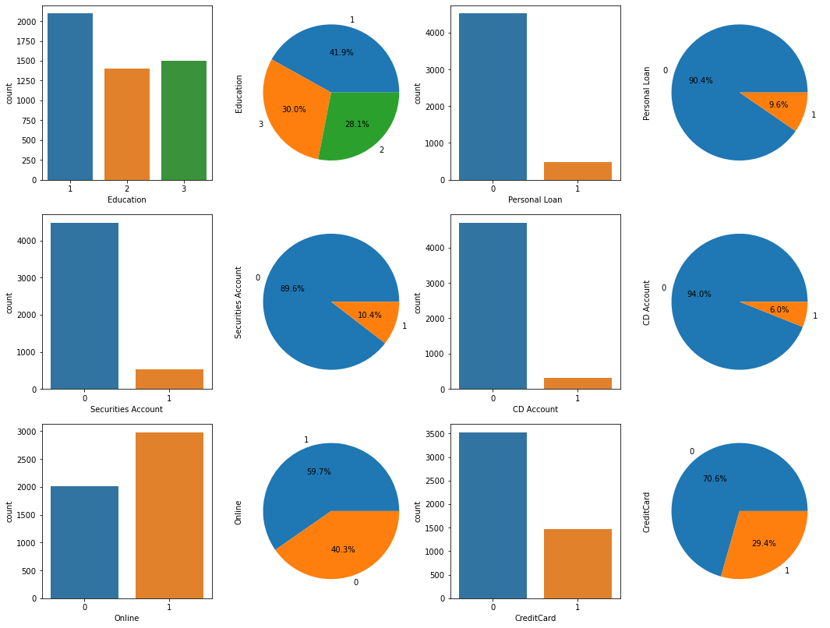
Descriptive Statistics Aspects
Descriptive Statistics
Univariate Analysis
Frequency Distribution via histograms and bar plots
Visual
Plots
Augments Plots
Quantitative
Values, Tables
9
7
Count
6
5
30 40 50 60 70 80 90 100
Marks
For Numerical Attributes
For Categorical Attributes

Slide 14
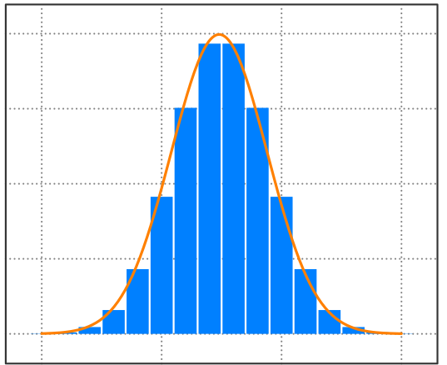
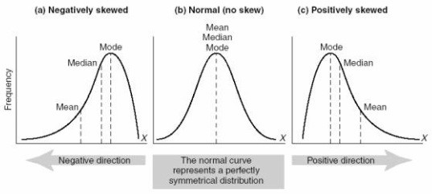
Descriptive Stats (cond.) Shape and Spread of Frequency Distribution
Shape
Central
Tendency
Bell–shaped?
Spread /
Dispersion
Left skewed
Right skewed
Symmetric
Asymmetric

Slide 15
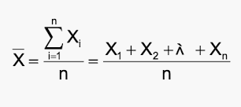
Descriptive Stats (cond.) Central Tendency and 3 Ms
Whenever you measure things of the same kind, a fairly large number of such measurements will tend to cluster around the middle value. Such a value is called a measure of “Central tendency”
3Ms:
1. Mean
The statistical mean refers to the mean or average that is used to derive the central tendency of the data.

Slide 16
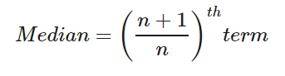
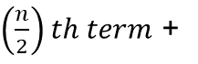
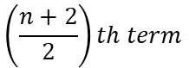
Descriptive Stats (cond.) Central Tendency and 3 Ms: Median
Median
2. Median
The middle value that separates the higher half from the lower half of the data set. The median and the mode are the only measures of central tendency that can be used for original data, in which values are ranked relative to each other but are not measured absolutely.
5,10,12, 11,14, 7, 8, 9, 13, 19, 24
5, 7, 8, 9, 10, 11, 12, 13, 14, 19, 24
Mean = 12.0
For Odd number of terms sequentially arranged
2
Median = Avg [ ]
$\left(\frac{n}{2}\right)th term$ +
$$\left(\frac{n+2}{2}\right)th term$$
For Even number of terms sequentially arranged

Slide 17
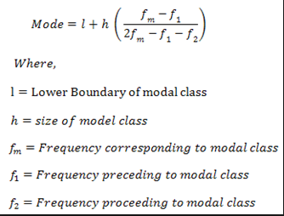
Descriptive Stats (cond.) Central Tendency and 3 Ms: Mode
3. Mode
The most frequent value in the data set. This is the only central tendency measure that can be used with nominal data, which have purely qualitative category assignments.
The Central Tendency Measure used for Categorical variable
Mode

Slide 18
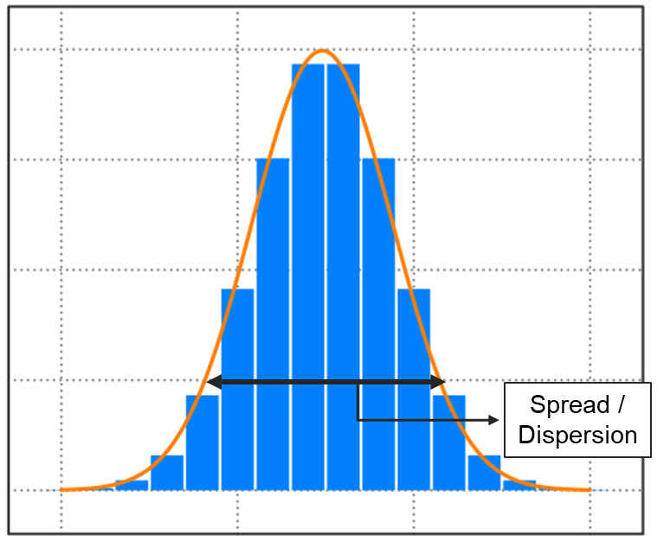
Descriptive Stats (cond.) Measures of dispersion: Range
Measures of dispersion
Measure of dispersion indicate how large the spread of
distribution in around the central tendency.
Range
Range is the simplest of all measures of dispersion. It is calculated as the difference between maximum and minimum value in dataset.
range = X(maximum) - X (minimum)

Slide 19
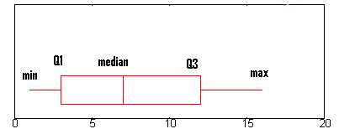
Descriptive Stats (cond.) Measures of dispersion: IQR
Inter Quartile Range (IQR)
Whisker 1:
5 = Min
Whisker 2:
21.75
IQR = 13.5-8.5 = 5
50%
Whisker 1: Q1 - 1.5*IQR
Whisker 2: Q3 + 1.5*IQR
25%
75%
5, 7, 8, 9, 10, 11, 12, 13, 14, 19, 24
Outlier

Slide 20
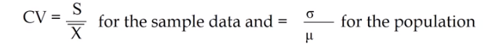
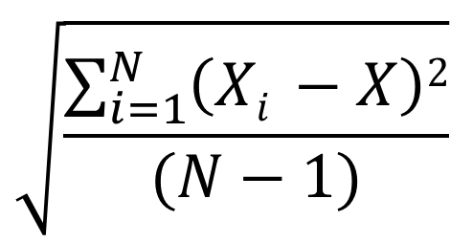
Descriptive statistics – Standard Deviation
Interpreting variance (a squared term) is not intuitive. Instead we under root it to get Standard deviation which has the same units as variable.
Standard deviation, is a measure of average spread i.e., on an average what is the difference between any data point and the central value of the variable.
Coefficient variation is defined as ratio of standard deviation to mean
$$\sqrt{\frac{\sum_{i=1}^{N}{\left(Xi −X\right)2}}{(N−1)}}$$
Variance
S_{d} =

Slide 21
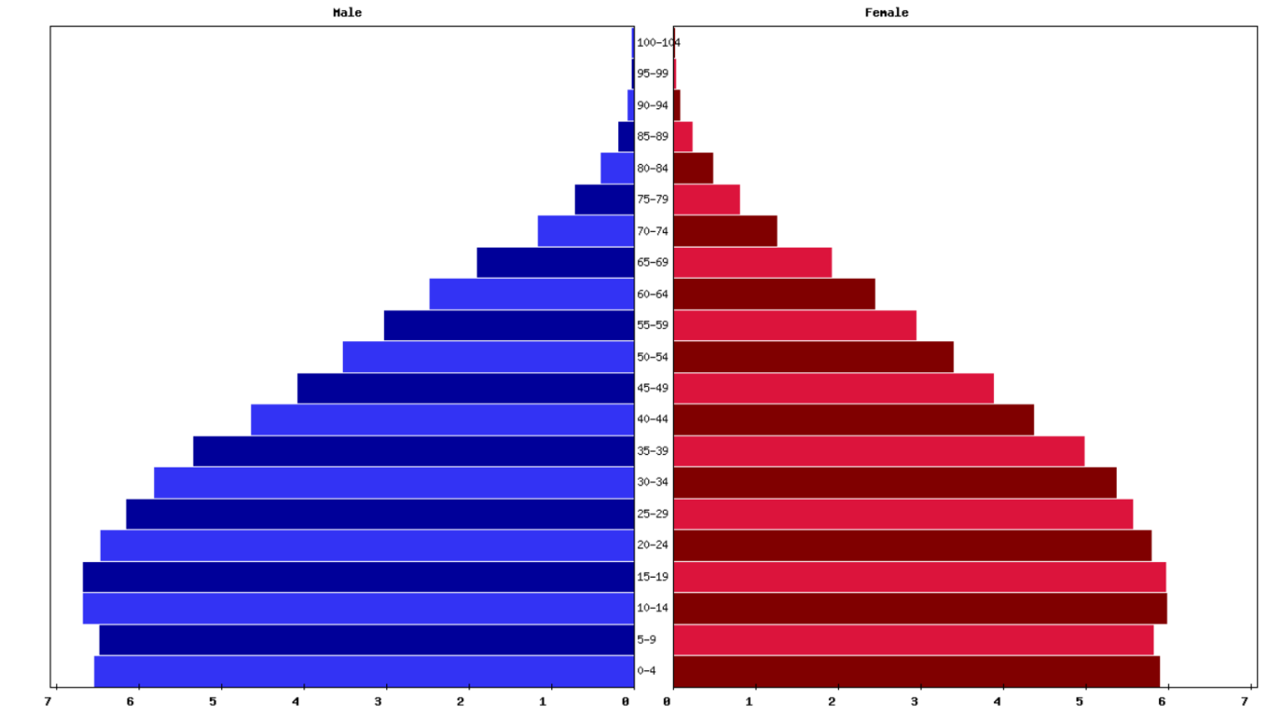
Example: Population distribution by age in India
(Max)
(Max)
Outliers
Outliers
STD_{m}=26.1
STD_{f}=23.5
Q3
Q3
Mean (28.)
Median
Median
Mean (26.1)
Mode
Q1
Q1
Min
Min
Population (in 10 M)
Population (in 10 M)

Slide 22
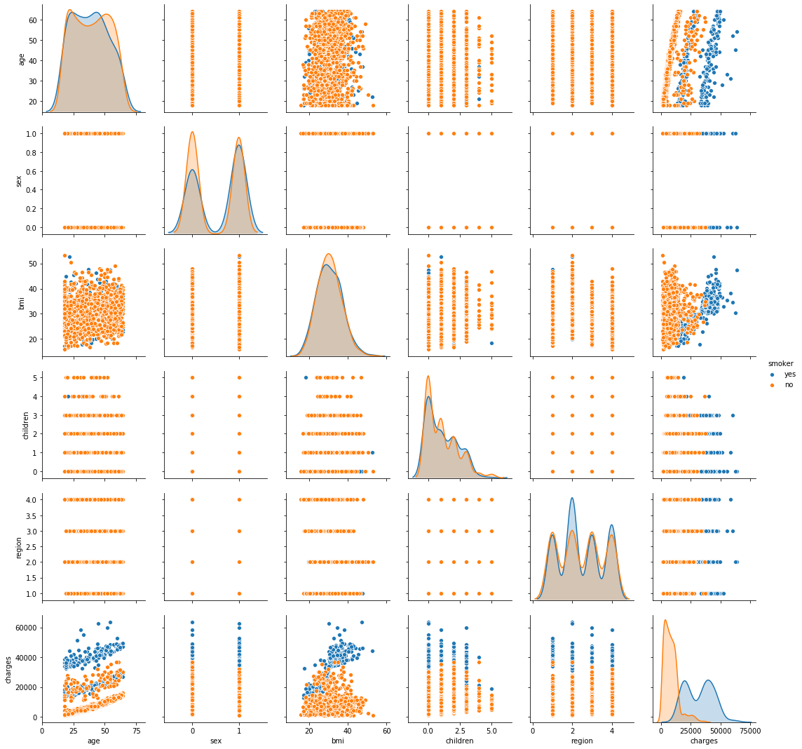
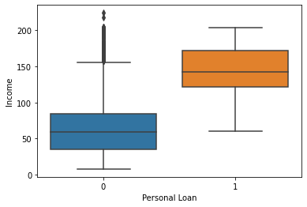
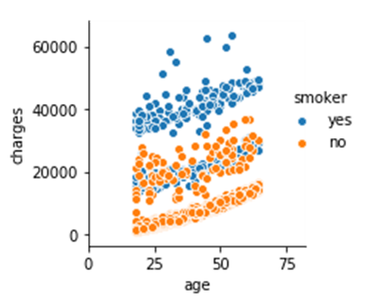
Descriptive Stats (contd.) Bivariates
P.Loan Education | No | Yes
Level 1 | 2003 | 93
Level 2 | 1221 | 182
Level 3 | 1296 | 205
Data Pair Types:
Crosstab
(pd.crosstab(X,Y)
Pivot Table
for multiple C-Cs
pd.pivot_table()
X Y | Categorical | Numerical
Categorical | C-C | C-N
Numerical | N-C | N-N
Outliers
Box Plots
(sns.boxplot()
sns.stripplot(),
sns.swarmplot(),
sns.violinplot() etc)
Scatter Plot (Bi-variate)
Pair Plot (Multi-variate)

Slide 23
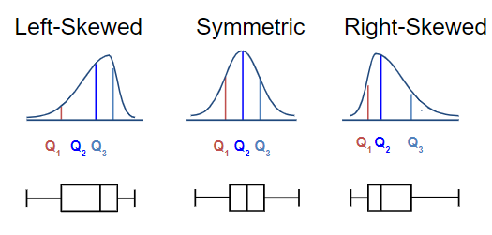
Descriptive Stats (contd.) Distribution Shape and the Boxplot

Slide 24
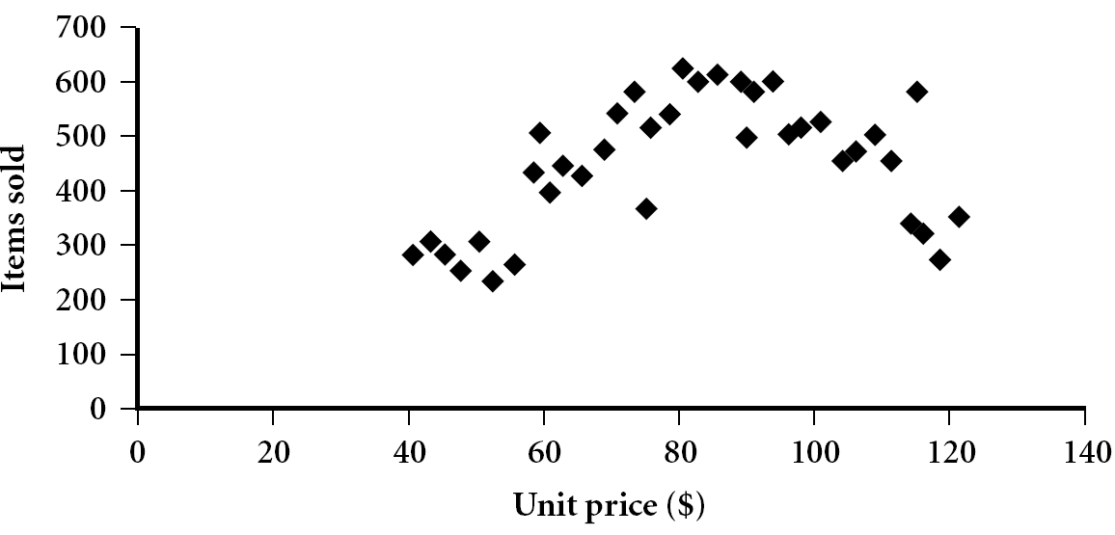
Scatter Plot
Provides a first look at bivariate data to see clusters of points, outliers, etc
Each pair of values is treated as a pair of coordinates and plotted as points in the plane

Slide 25
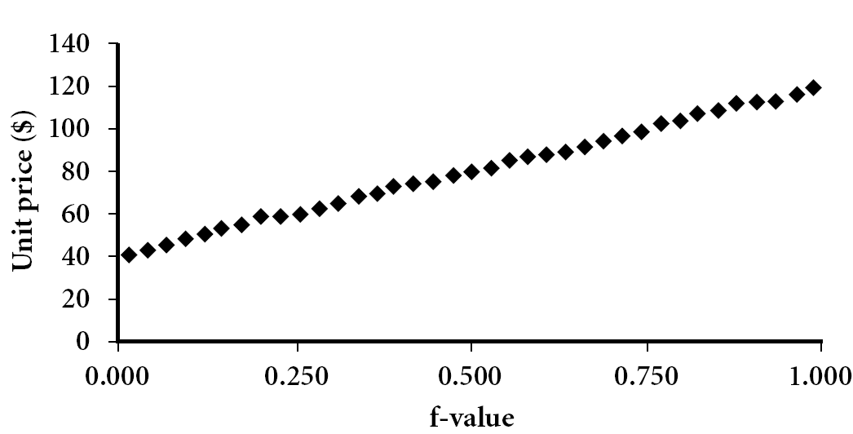
Descriptive Stats (contd.) Quantile Plot
Displays all of the data (allowing the user to assess both the overall behavior and unusual occurrences)
Plots quantile information
For a data x_{i} data sorted in increasing order, f_{i} indicates that approximately 100 f_{i}% of the data are below or equal to the value x_{i}

Slide 26
Descriptive Stats (contd.) Example of Quantile plot
Marks Class A = [35. 38. 44. 53. 58. 65. 67. 72. 77. 91.]
Marks Class B = [29. 43. 44. 57. 59. 65. 69. 77. 84. 90.]
100.
90.
80.
70.
60.
50.
40.
30.
20.
Class A Marks
0.0 0.1 0.2 0.3 0.4 0.5 0.6 0.7 0.8 0.9 1.0
f-value

Slide 27
Descriptive Stats (contd.) Example of Q-Q plot
Marks Class A = [35. 38. 44. 53. 58. 65. 67. 72. 77. 91.]
Marks Class B = [29. 43. 44. 57. 59. 65. 69. 77. 84. 90.]
100.
90.
80.
70.
60.
50.
40.
30.
20.
Class B Marks
20. 30. 40. 50. 60. 70. 80. 90. 100.
Class A Marks

Slide 28
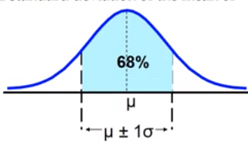
Descriptive Stats (cond.) The Empirical Rule
The Empirical rule
The empirical rule approximates the variation of data in a bell-shaped distribution.
Approximately 68% of the data in a bell shaped distribution is within 1 standard deviation of the mean 95% within 2 σ s and 99.7% within 3 σs
“Bell-Shaped” → “Normal Distribution” → “Gaussian”
μ + 2σ (95%)
μ + 3σ (99.7%)

Slide 29
Descriptive Stats (cond.) The Empirical Rule and Chebyshev Rule
Chebyshev Rule
Regardless of how the data are distributed, at least (1-1/k²)x100% of the values will fall within k standard deviations (for k>1)
For example, when k=2, at least 75% of the values of any data set within 2σs

Slide 30
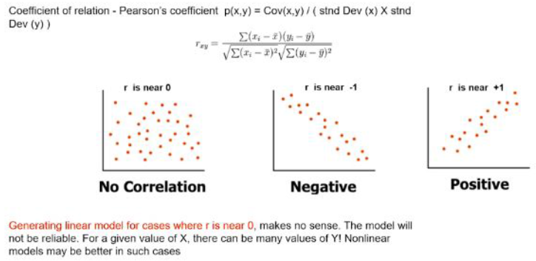
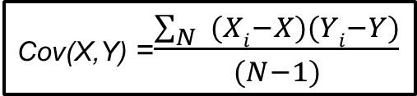
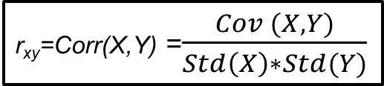
Descriptive Stats (contd.) Measures of Associate amongst Bivariates
Y
Rectangle is 2D
dispersion in data →
ΣRectangles
Covariance
Covariance is a measure of association between 2 variables.
It represents association in units of the two variables.
Correlation
Correlation is also a measure of association between two variables.
Moreover, it is a dimensionless quantity and thus enables
comparison beyond units.
Coefficient of correlation is also known as Pearson’s coefficient
(X_{i}, Y_{i})
Std (Y)
Y
Cov (X_{i},Y_{i})
X
X
Std (X)
Cov(X,Y) =$\frac{\sum_{N}{ (Xi−X})(Yi−Y)}{(N−1)}$
units²
r_{xy}=Corr(X,Y) =$\frac{Cov (X,Y)}{Std\left(X\right)∗Std(Y)}$

Slide 31
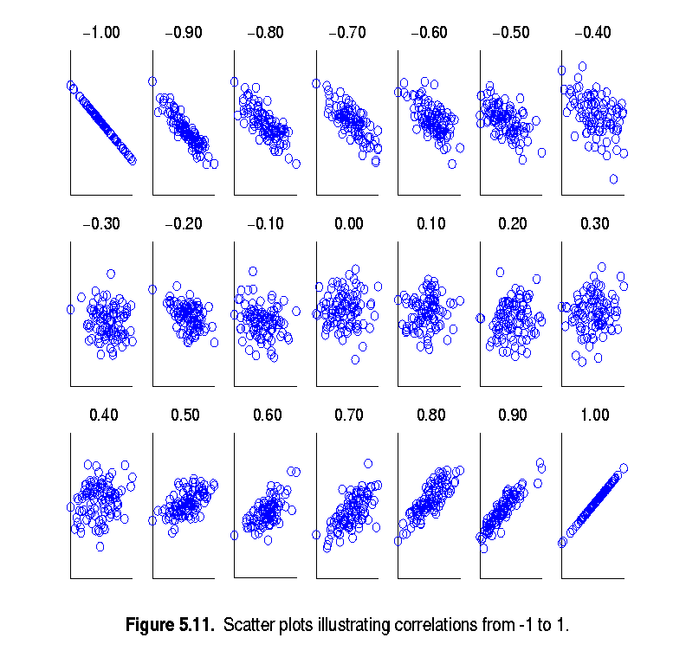
Descriptive Stats (contd.) Visually Evaluating Correlation
Scatter plots showing the similarity from -1 to 1

Slide 32
Descriptive Statistics Data Visualization Summary
Why data visualization?
Gain insight into an information space by mapping data onto graphical primitives
Provide qualitative overview of large data sets
Search for patterns, trends, structure, irregularities, relationships among data
Help find interesting regions and suitable parameters for further quantitative analysis
Provide a visual proof of computer representations derived
Categorization of visualization methods:
Pixel-oriented visualization techniques
Geometric projection visualization techniques
Icon-based visualization techniques
Hierarchical visualization techniques
Visualizing complex data and relations

Slide 33
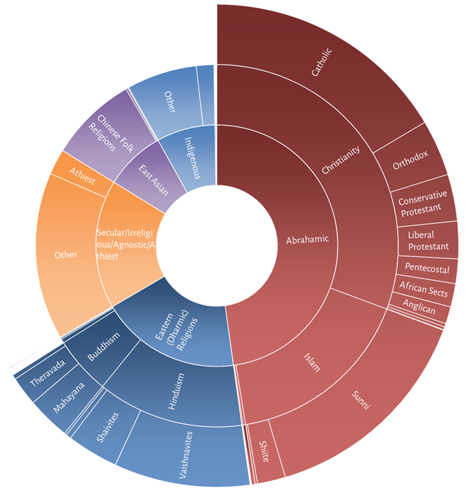
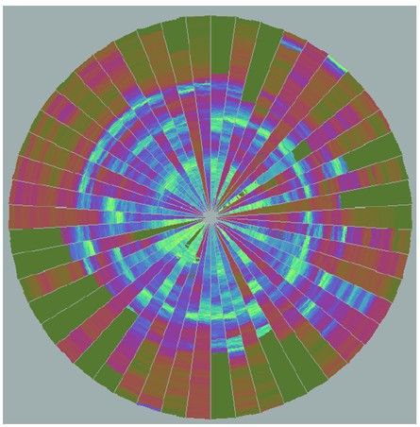
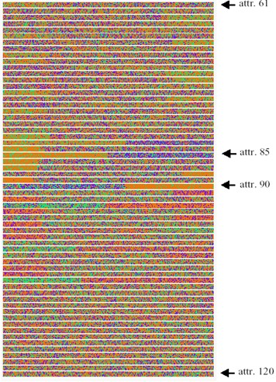
Descriptive Statistics Data Visualization (Advanced)
Tracking 50 stock prices over time
DNA map with 120 attributes
Pixel Oriented Visualization
Heirarchical Visualization

Slide 34
Applied Stats: Week 1 Summary
Statistics Introduction
Descriptive Statistics with varied Data
Measures of central tendency: mean, mode, median
Measures of dispersion: range, IQR, variance, std deviation, coefficient of variation.
Normal distribution, Chebyshev Rule.
Five number summary, boxplots, QQ plots, Quantile plot, scatter plot.
Visualization: scatter plot matrix
Correlation analysis.

Slide 35
Case Study
Churn in Telecom’s dataset-
The dataset is about telecom industry which tells about the number of customers who churned the service. It consists of 3333 observations having 21 variables. We have to predict which customer is going to churn the service.
Dataset -
The dataset contains State, Account Length, area code, phone number, international plan, voice mail plan and important variables like call charges, international call charges, customer service calls, etc.
For Reference: https://www.kaggle.com/blastchar/telco-customer-churn

Slide 36
Steps Followed
Objective - Predict behavior to retain customers. You can analyze all relevant customer data and develop focused customer retention programs.
Steps-
Import pandas, numpy, seaborn, matplotlib.pyplot packages
Get the data
Calculate histogram for minutes per day spent by customers.
How do we categorize the churner and the non-churner for the time spent on day calls?
Find the number of customers who did opt for voicemail plan.
Create a boxplot for a categorical variable and continuous variable.
How to pivot information using python for categorical values?
Understand the correlation between all variables.
Plot a distplot to check total night calls.
Calculate area wise churner or non-churner

Slide 37
Resources
https://towardsdatascience.com/an-introduction-to-statistics-part-1-e056837afa8e
https://towardsdatascience.com/basic-statistics-you-need-to-know-for-data-science-1fdd290f59b5
https://www.book2look.com/embed/9781317526988
https://machinelearningmastery.com/statistics-books-for-machine-learning/

Slide 38


Questions?

